Slide 1
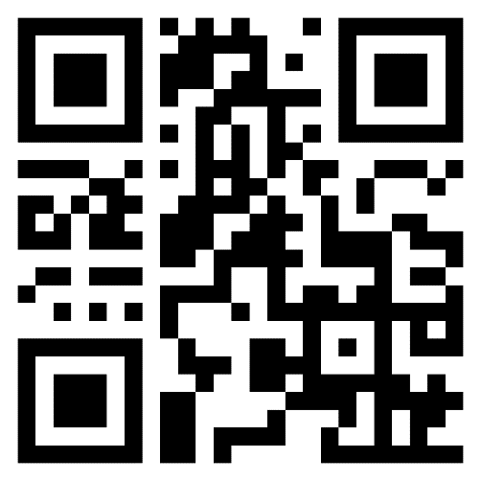
WACUBO 2025
Business Management Institute
CHECK-IN
POINT
Point your phone’s camera at the QR code
or
Navigate to https://wacubo.cnf.io
Tap session matching this room
Keep browser window open to check out at session’s end

Slide 2
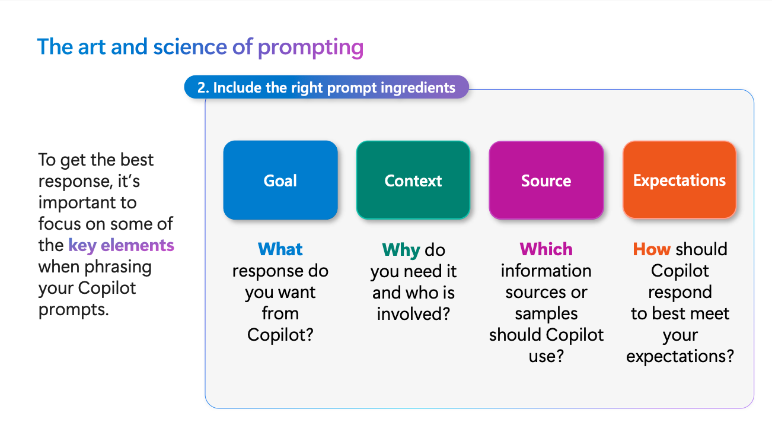
The Art of Prompt Generation
Using Microsoft’s GCSE method.
Presenter: Sarem Yadegari
Presentation Curated for: WACUBO BMI

Slide 3
What we will cover today
What makes a good prompt
Understanding prompt structure
The art of prompting using the GCSE framework
Example of GCSE framework
Extending the prompt’s purpose
Giving feedback to AI
Practice

Slide 4
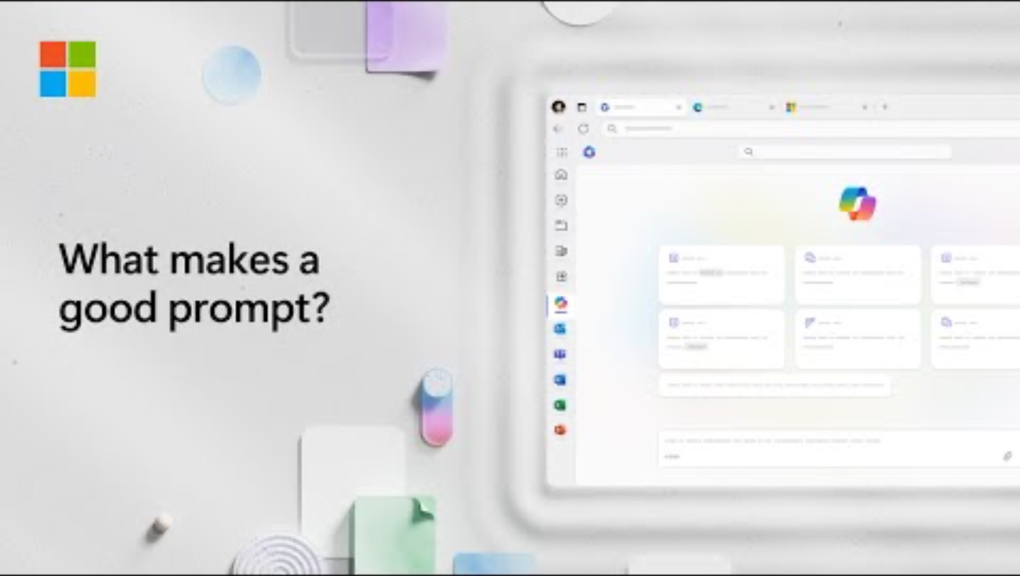
What makes a good prompt

Slide 5
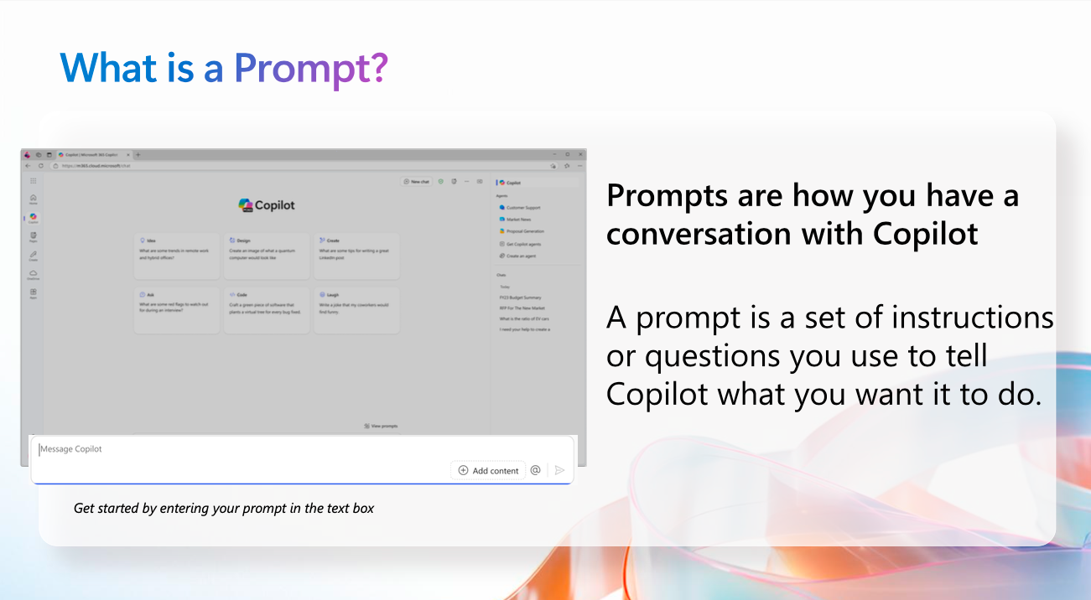
Understanding prompt structure

Slide 6
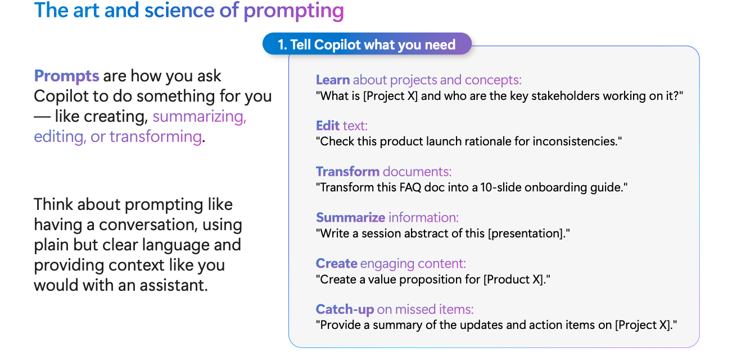
The art of prompting using the GCSE framework

Slide 7
The art of prompting using the GCSE framework

Slide 8
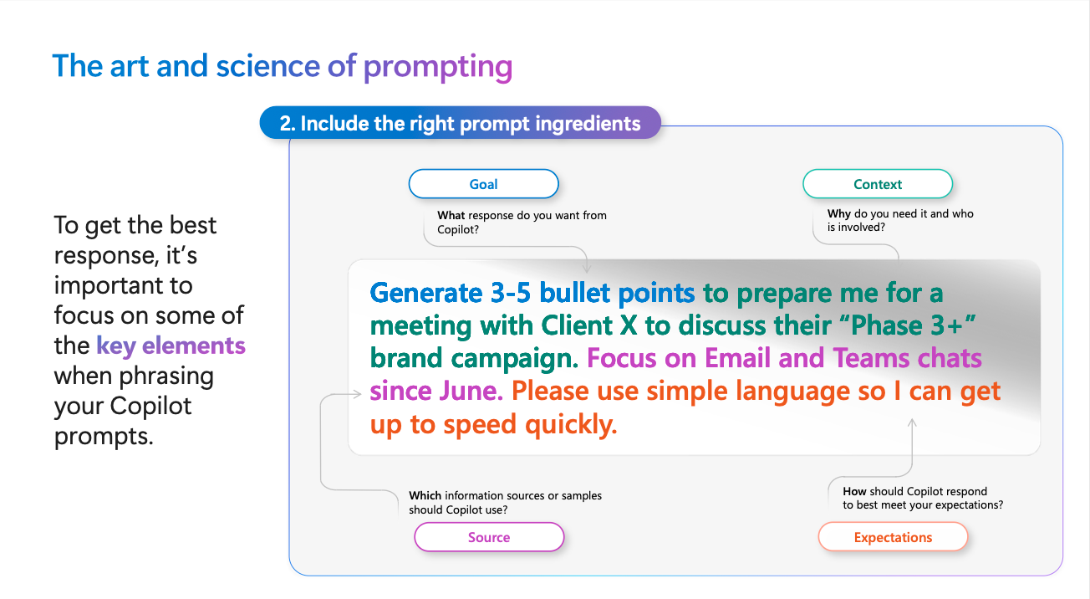
The art of prompting using the GCSE framework

Slide 9
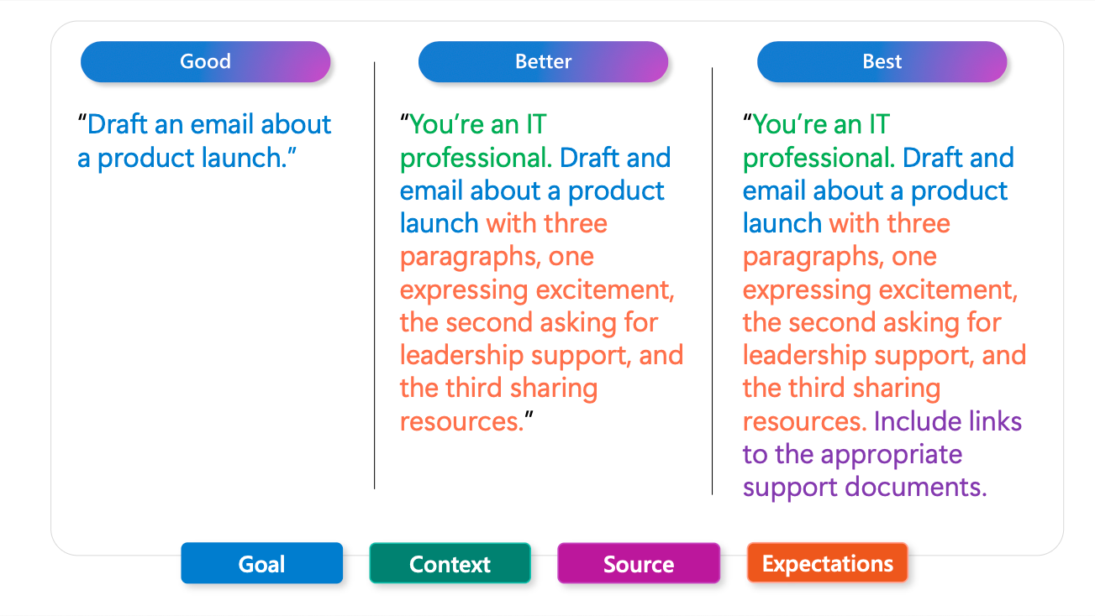
The art of prompting using the GCSE framework

Slide 10
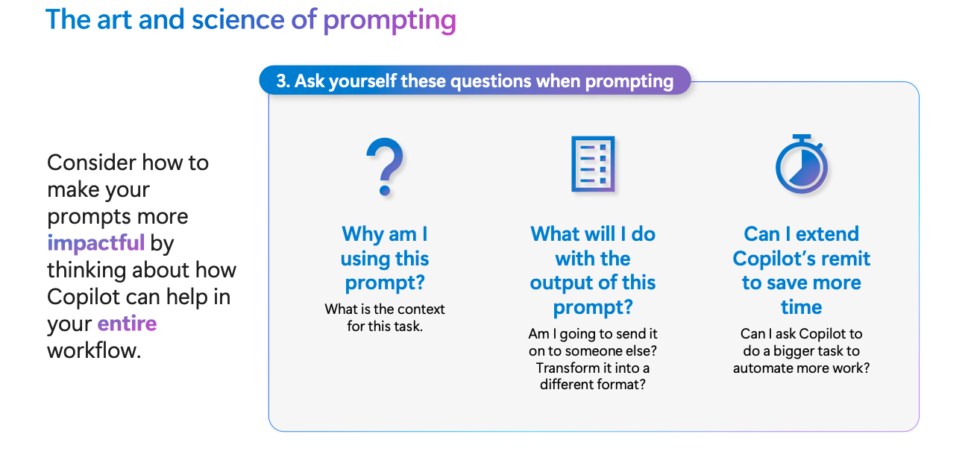
The art of prompting using the GCSE framework

Slide 11
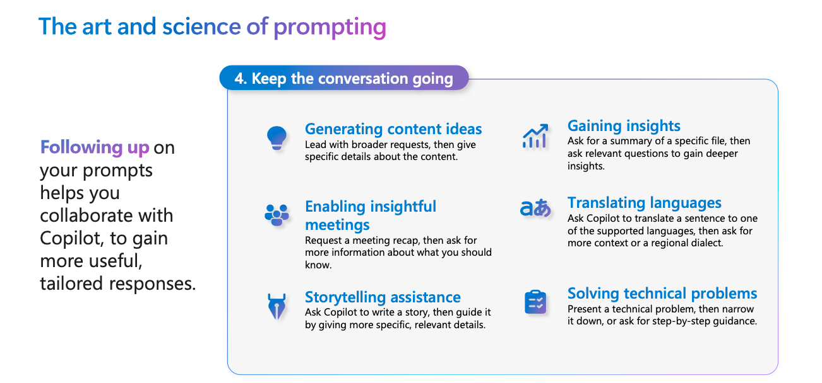
The art of prompting using the GCSE framework

Slide 12
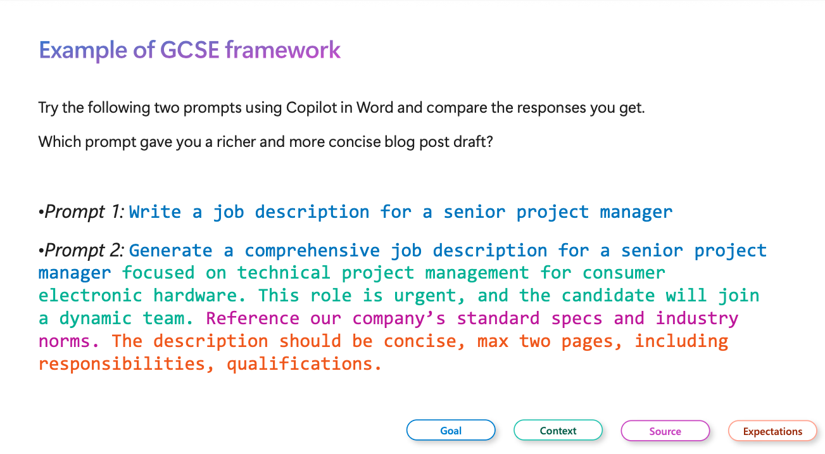
Example of GCSE framework

Slide 13
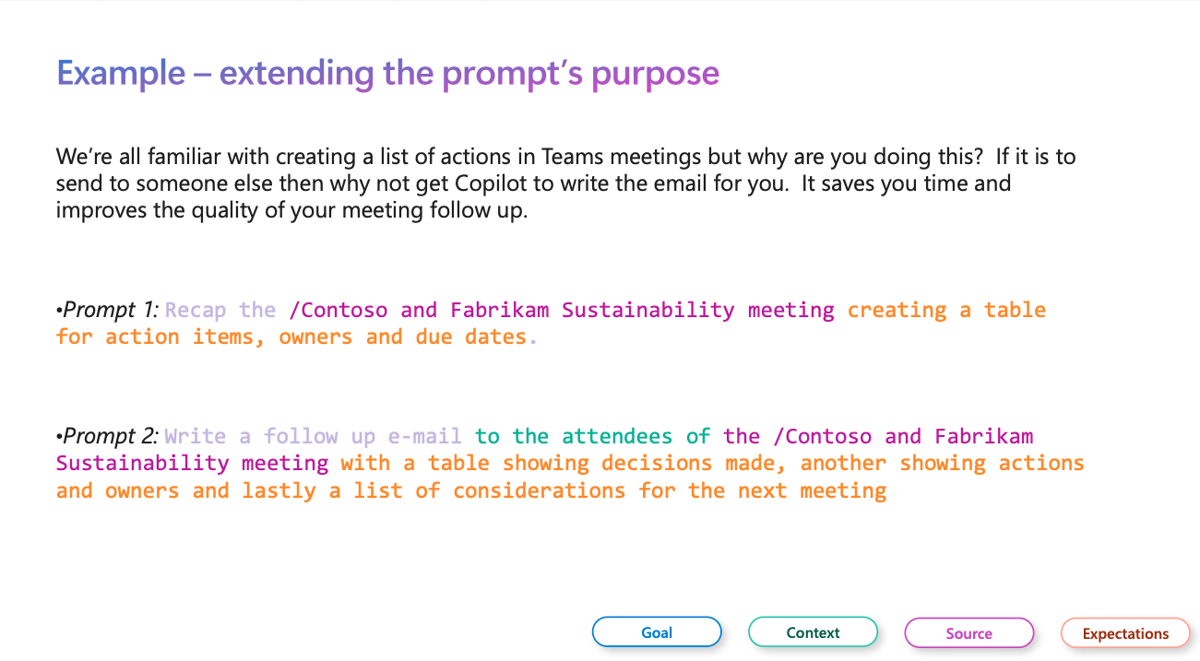
Extending the prompt’s purpose

Slide 14
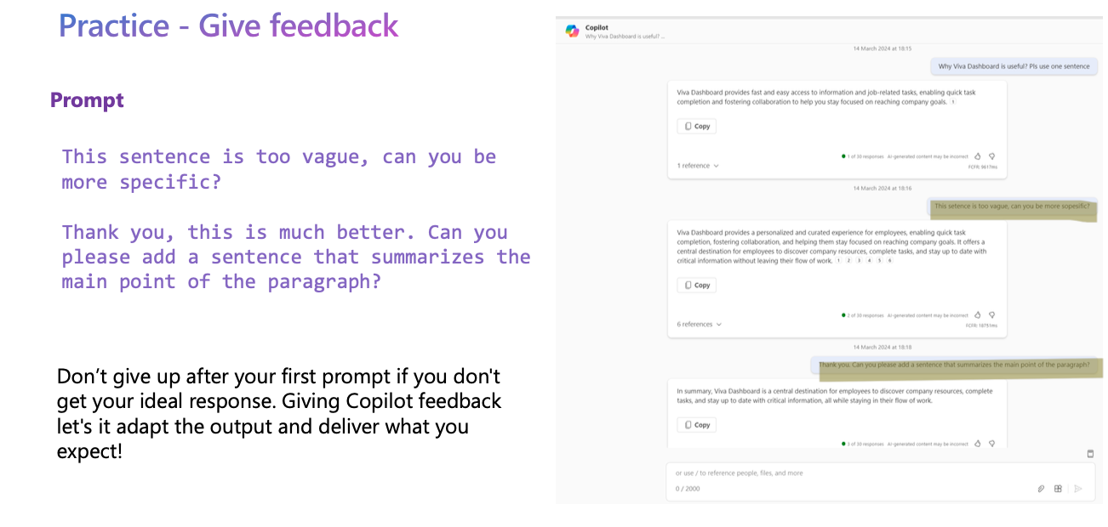
Giving feedback to AI

Slide 15
Practice
Use Microsoft Copilot for Web or your preferred AI tool to run prompts on the topic of your choosing. Create good, better, and best prompts, based on the GCSE concept.
Share your prompts with the person next to you.
Notes:
Open with a quick show of hands: Who has staff using AI? Who knows which tools? Who has a policy?
Frame this as stewardship: efficiency + risk management + governance.
[Sources]
- EDUCAUSE (2024). 2024 EDUCAUSE AI Landscape Study.
- EDUCAUSE (2024). 2024 EDUCAUSE Action Plan: AI Policies and Guidelines.

Slide 16

Presentation Summary and Slides
Scan the QR Code to access the presentation slides.
Notes:
Include links in your LMS/handout or QR code in the final slide.

Slide 17
Looking to Obtain CPEs?
Don’t forget to Check-Out from the system!

Slide 18
References
Learn about Copilot prompts
Get better results with Copilot prompting
Craft effective prompts for Microsoft 365 Copilot
How to create a great Microsoft Copilot prompt | Microsoft Copilot Tutorial
Notes:
Include links in your LMS/handout or QR code in the final slide.

