Slide 1

WACUBO 2025
Business Management Institute
CHECK-IN
POINT
Point your phone’s camera at the QR code
or
Navigate to https://wacubo.cnf.io
Tap session matching this room
Keep browser window open to check out at session’s end

Slide 2
Microsoft Copilot Web
Introduction to Copilot, features, and benefits.
Presenter: Sarem Yadegari
Presentation Curated for: WACUBO BMI

Slide 3
What we will cover today
Different Microsoft Copilots
Copilot Chat
Microsoft 365 Copilot
Work IQ
5 in 1 capabilities with M365 Copilot
Availability across apps
Key use cases
How to chat in 3 steps

Slide 4


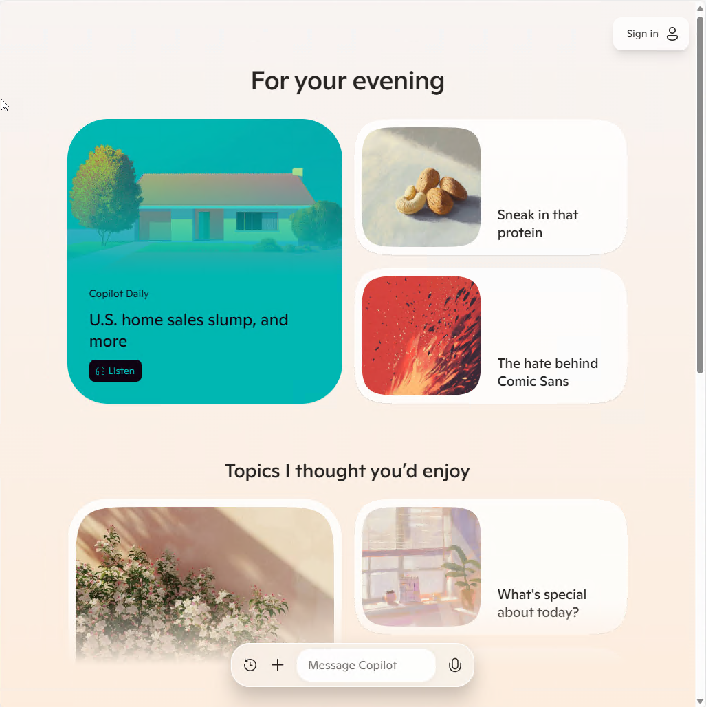
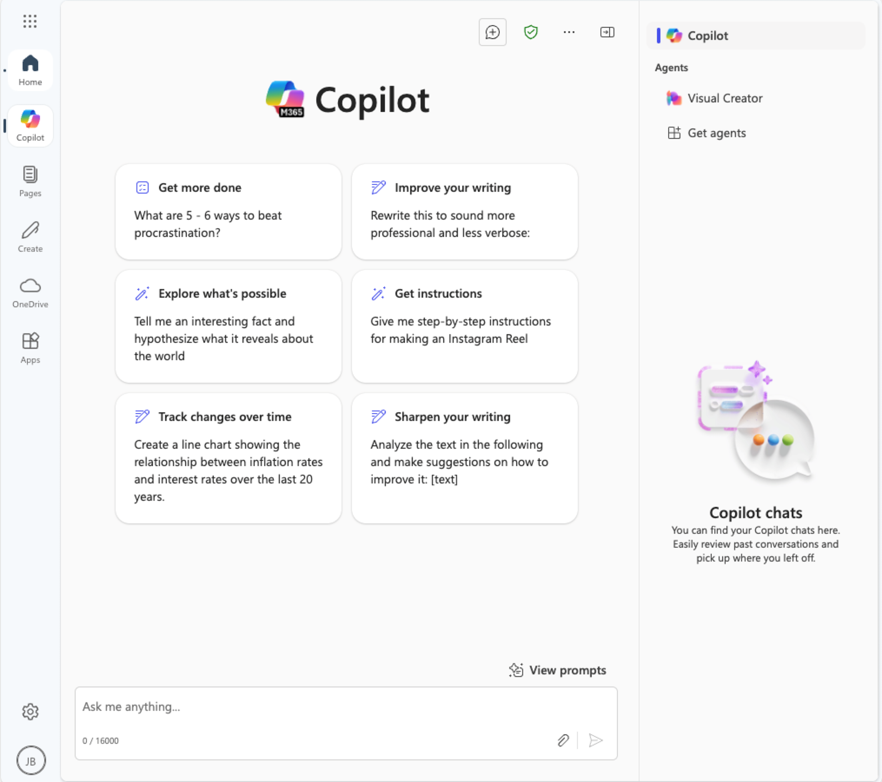
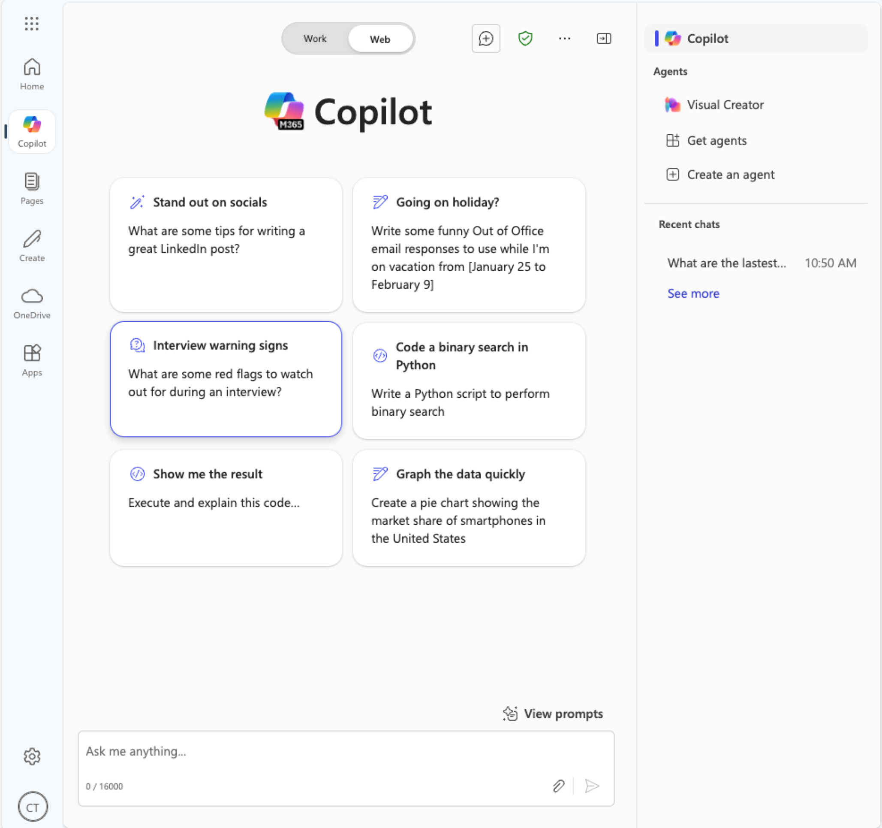

Different Microsoft Copilots
Entra ID signed in user
+ Microsoft 365 Copilot license
Copilot Personal
Microsoft 365 Copilot Chat
Microsoft 365 Copilot

Slide 5

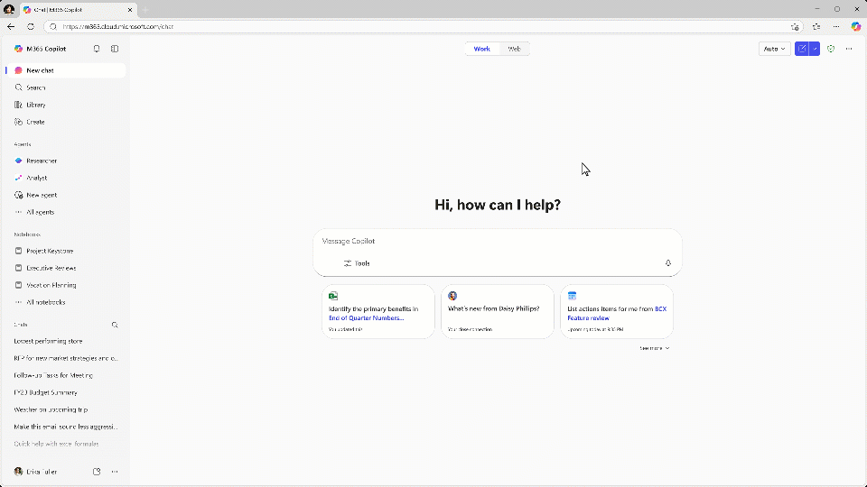
Copilot Chat
Secure AI chat powered by the latest models available and Work IQ intelligence layer.

Slide 6

Microsoft 365 Copilot
Copilot Chat
Free and secure
Web-grounded AI chat & agents
Pay as you go custom agents
GPT-5 standard access
Chat
Work-grounded
GPT-5 priority access
Microsoft 365 Copilot
Copilot in Microsoft 365 apps
Full agent access
Pre-built Microsoft agents
Analyst & Researcher advanced reasoning agents
Custom agents grounded in your data¹
Copilot Control System
Copilot Analytics
Learn about standard and priority GPT-5 access here. 1. Applies to assistive agents built by you on the Microsoft 365 Copilot agent platform deployed on Microsoft 365 surfaces

Slide 7


Work IQ
Microsoft Work IQ is an AI-powered intelligence layer for Microsoft 365 Copilot that acts as a "brain" for enterprise AI, connecting user data, work patterns, and organizational context.
Your style, habits, relationships, and workflows
Contextual insights and predictive actions from across your data and memory
Memory
Inference
You at work
Your organization and individual content like files, emails, and meetings – Plus line of business data
Data

Slide 8
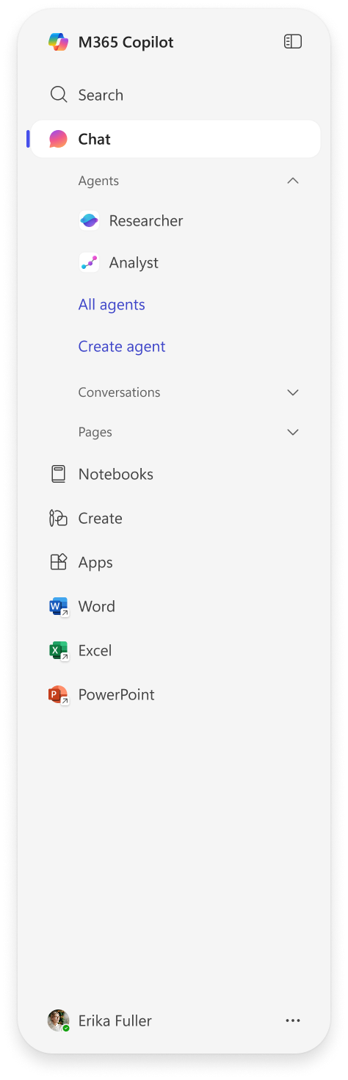

5 in 1 capabilities with M365 Copilot
Chat
Search
Agents
1
2
3
2
1
Secure AI chat powered by the latest models, grounded in web and work data.
AI-powered search spans all your work data and provides fast and relevant results.
A broad ecosystem of pre-built agents available in the Agent Store and tools to build your own agents with Copilot Studio.
3
4
5
Notebooks
Create
4
5
Copilot is grounded in your project’s diverse content types to provide targeted responses and engaging audio overviews.
AI-generated images, posters, banners, videos, and more that are aligned to your organization’s brand identity.

Slide 9
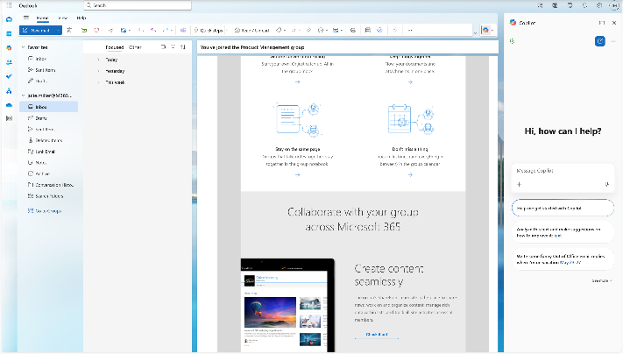







Available across M365 apps
Microsoft 365 Copilot Chat are available as a side-by-side experience in Word, Excel, PowerPoint, Outlook, OneNote, and Teams, to help users access AI in their flow of work.
Copilot Chat will open in the side pane and users can manage this behavior through their settings in the app.

Slide 10
Key use cases for Copilot chat
Summarization of Document: Copilot Chat can help users quickly summarize lengthy document.
Generating Creative Content: Users can leverage Copilot Chat to generate creative content such as stories, poems, and other written materials.
Providing Quick Answers and Explanations: Copilot Chat can be used to provide quick answers to questions and explanations on various topics, enhancing productivity.
Helping with Research: Copilot Chat can help to perform research for industries, markets, competitors, and products.

Slide 11

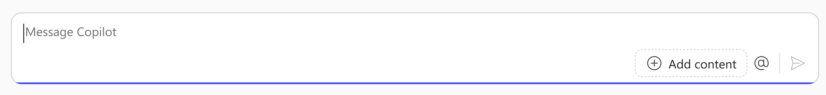

How to chat in 3 steps
1
2
3
Enter your prompt
Check sources
Continue the conversation
Enter your detailed prompt in the text box at the bottom. If you would like Copilot to source information from any reference files, you can upload them in your prompt by selecting the “Add content” button.
Copilot Chat is transparent about the sources of its information. See these sources listed underneath the answer.
Vet these sources and validate your answers.
You can ask follow-up questions as you would in a conversation. You can refine the answer too.
For example, try “Write a shorter answer” or “Give me more detail.” You can also select suggested prompts.

Slide 12
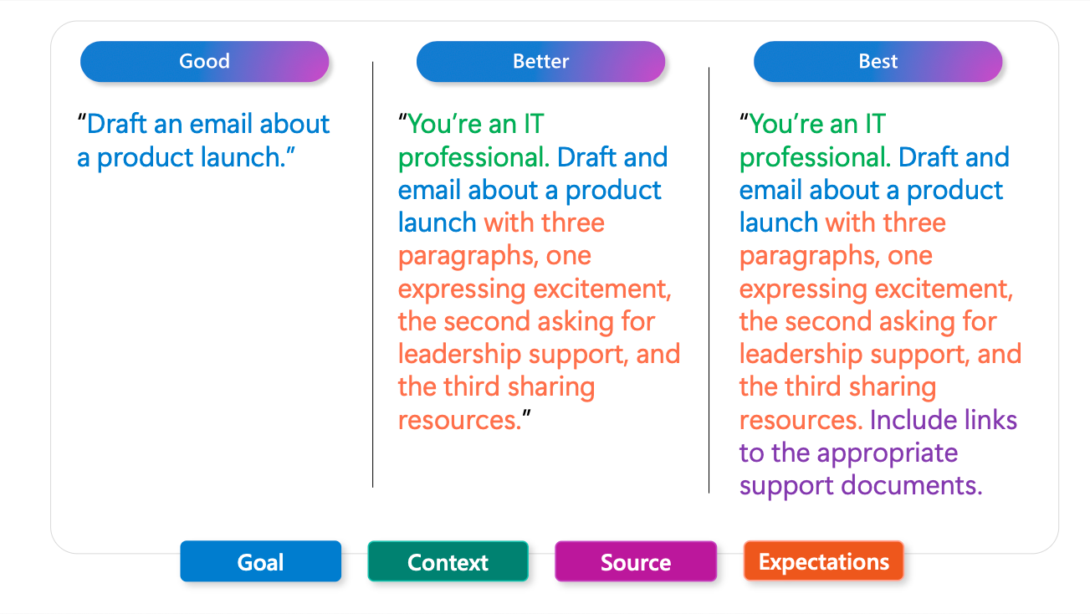
The art of prompting using the GCSE framework

Slide 13
Live Demo

Slide 14

Presentation Summary and Slides
Scan the QR Code to access the presentation slides.
Notes:
Include links in your LMS/handout or QR code in the final slide.

Slide 15
Looking to Obtain CPEs?
Don’t forget to Check-Out from the system!

Slide 16
References
Learn about Copilot prompts
Get better results with Copilot prompting
Craft effective prompts for Microsoft 365 Copilot
How to create a great Microsoft Copilot prompt | Microsoft Copilot Tutorial
Notes:
Include links in your LMS/handout or QR code in the final slide.

