Slide 1

WACUBO 2025
Business Management Institute
CHECK-IN
POINT
Point your phone’s camera at the QR code
or
Navigate to https://wacubo.cnf.io
Tap session matching this room
Keep browser window open to check out at session’s end

Slide 2
Introduction to Generative AI:
For Higher Education Business Leaders
Presented by Sarem Yadegari
WACUBO Business Management Institute, Summer 2026

Slide 3
Let’s Start With A Poll!
Which best describes your use of AI today?
*To answer: Open your browser and visit PollEV.com/sarem
Responses are anonymous.
*Viewing the slides later? This poll was conducted live during the live session and is no longer accepting responses, but we encourage you to consider the questions and reflect on your own experiences with AI.

Slide 4
Why This Conversation Matters
57% (2025)
34% (2025)
56%+ (2025)
view AI as strategic priority [1]
underestimate AI costs [2]
faculty and staff view AI training as important [2]
Rising service expectations from students and stakeholders demand new operational efficiencies that traditional approaches cannot deliver.
Campus workloads are increasing while staffing remains constrained, creating unsustainable pressure on business operations.
Compliance requirements and data privacy risks are expanding across FERPA, accessibility, and procurement domains.
AI tools are already in active use across your campus, often without governance frameworks or risk management protocols.

Slide 5

AI Is Already Embedded
in Everyday Tools
Microsoft 365 Copilot and Google Workspace AI assistants are embedded in daily productivity tools across campus offices.
Writing tools, including Grammarly and citation managers, now use generative AI for content suggestions.
Enterprise resource planning, CRM, and HR systems increasingly incorporate AI-powered analytics and automation features.
Learning management systems deploy AI for personalized recommendations, early alerts, and adaptive content delivery.

Slide 6

What Is Generative AI?
Generative AI systems analyze massive datasets to identify statistical patterns and relationships between concepts, words, and structures.
These tools generate new text, images, or code by predicting what comes next based on those learned patterns, not by accessing a database of facts.
The system drafts content, offers suggestions, and provides starting points that require human judgment, verification, and final decision-making.
Outputs reflect training data patterns, meaning these systems amplify existing content rather than creating genuinely novel insights or verifying accuracy.

Slide 7
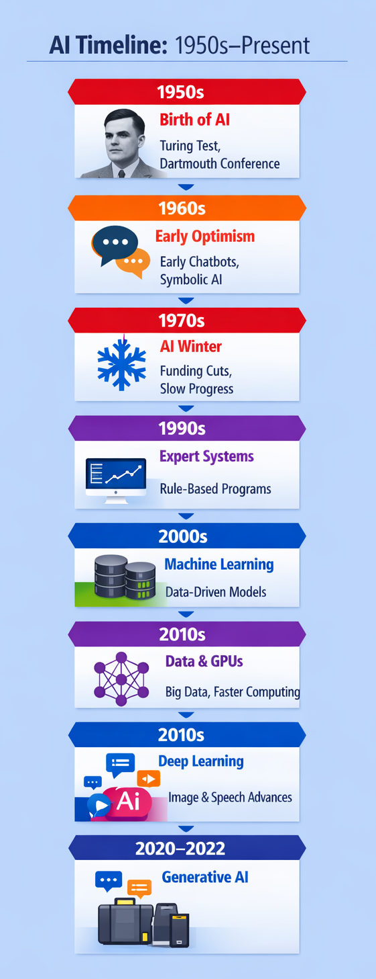
A Very Brief History
Artificial intelligence research spans seventy years, but recent advances in computing power and data availability enabled practical applications at scale.
The transformer architecture breakthrough in 2017 allowed models to process language context more effectively than previous approaches.
ChatGPT's November 2022 release democratized access to generative AI, reaching one million users within five days and accelerating enterprise adoption.

Slide 8
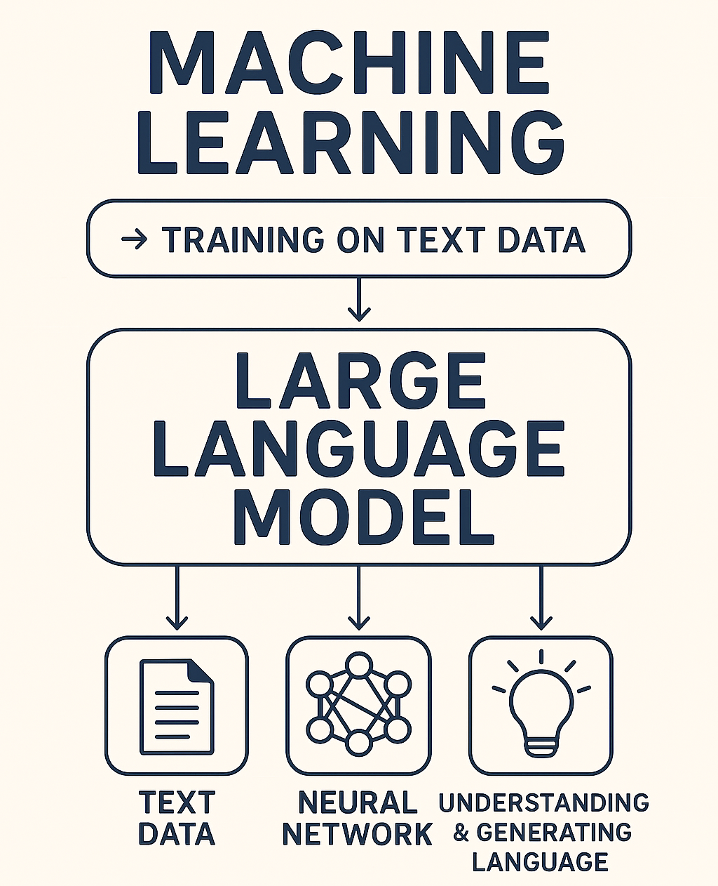
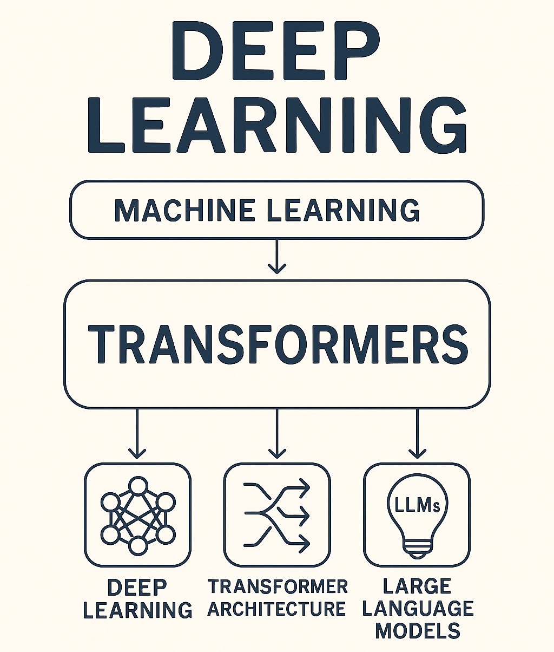
How These Systems Work (Conceptually)
Large Language Models (LLMs) learn statistical patterns from training data by predicting the next word in billions of text sequences, building relationships between concepts.
These systems generate responses by calculating the most probable sequence of words given the input prompt, not by retrieving verified facts from a knowledge base.
Confidence in delivery bears no relationship to accuracy—models generate authoritative-sounding responses regardless of underlying correctness. [5]
Grounding techniques that connect AI outputs to specific authoritative sources reduce but do not eliminate risk of inaccurate or fabricated information.

Slide 9
Key AI Terms (At a Glance)
Artificial Intelligence
Broad field of machine-based systems
making predictions or decisions
Machine Learning
Artificial intelligence encompasses any machine-based system that can make predictions, recommendations, or decisions influencing environments [3]
Most current generative AI applications use large language models, a specific type of deep learning architecture trained on massive text datasets
Understanding these distinctions helps business leaders evaluate vendor claims, assess procurement decisions, and communicate effectively with technical teams
Subset of AI where systems learn patterns from data without explicit programming
Deep Learning
Advanced machine learning using neural networks with multiple layers
Large Language Models
Deep learning models trained on text to generate human-like language

Slide 10
What Generative AI Is Good At
Drafting
First drafts of routine communications, policy summaries, meeting notes
Improving Clarity
Institutions report significant time savings on routine documentation tasks, including budget narratives, compliance reports, and stakeholder communications.
AI tools excel at reformatting existing content for different audiences, such as converting technical reports into executive summaries or board presentations.
Administrative teams use AI to synthesize information from multiple sources, identify patterns in operational data, and prepare initial analysis for strategic decisions.
Simplifying technical language, formatting consistency, tone adjustment
Reducing Admin Burden
Automating repetitive tasks, template generation, data summarization
Decision Support
Scenario analysis, trend identification, pattern recognition in large datasets

Slide 11

What Generative AI Is NOT
Not sentient or conscious—these systems execute statistical pattern matching without understanding, reasoning ability, or awareness of context beyond training data.
Not consistently accurate or reliable—hallucination rates range from 15% to 82% depending on model, task complexity, and prompting methods. [6]
Not a system of record or authoritative source—outputs require verification against institutional data, policies, and official documentation before use.
Not legally or ethically accountable—responsibility for AI-assisted decisions remains entirely with the human users and institutional leadership.

Slide 12
Hallucinations & Errors
$67.4B (2024)
47% (2026)
Global losses from AI hallucinations in 2024 [6]
Of executives made major decisions on unverified AI content [6]
Systems fabricate citations to non-existent research, invent policy language, and create plausible but entirely fictional financial data or compliance requirements.
AI outputs sound authoritative and confident while being completely wrong, using phrases like "definitely" and "certainly" more frequently when generating incorrect information. [5]
Leading law firms, academic researchers, and healthcare organizations have documented costly errors from unverified AI-generated content in court filings, publications, and patient care.
Every quantitative claim, policy reference, and regulatory citation from AI tools requires human verification against authoritative institutional sources before use.

Slide 13
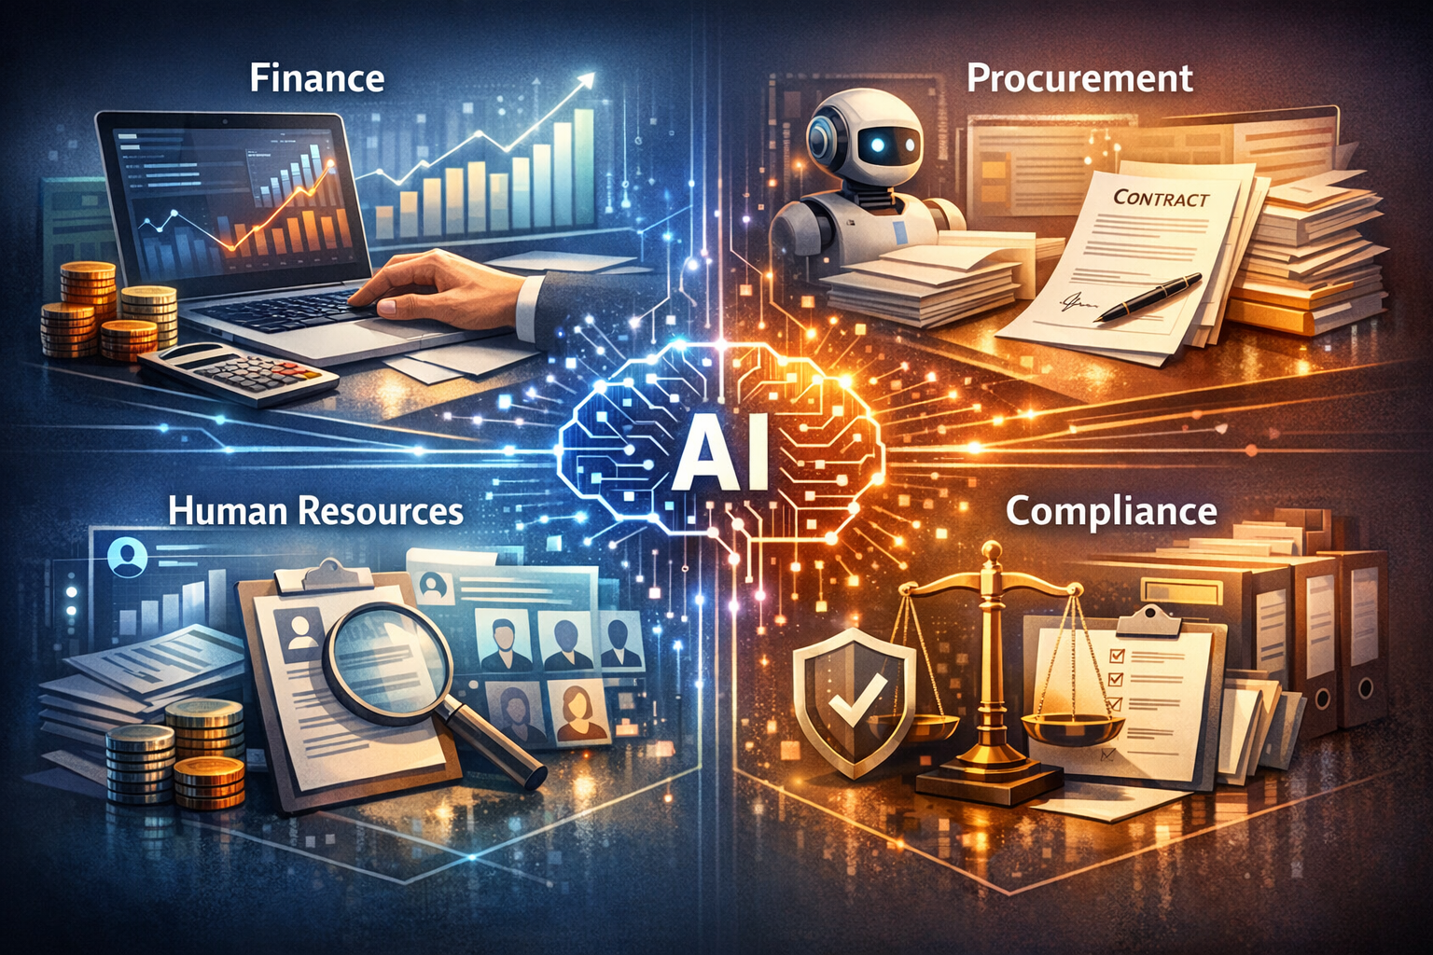
Where Higher Education
Business Offices Are Using AI
Finance and budgeting teams use AI for variance analysis, forecast modeling, and trend identification.
Procurement and contracts offices deploy AI to summarize vendor proposals and draft initial contract language
Human resources departments apply AI for job description drafting, benefits communication, and resume screening.
Comparing institutional policies and summarizing findings.
Student Services AI Chatbots and Virtual Assistants

Slide 14
Opportunity vs. Risk
Opportunities
Risks
Speed and efficiency gains free staff capacity for higher-value strategic work and stakeholder relationship building.
Administrative burden reduction allows teams to focus on analysis and activities requiring human judgment.
Content quality improvements through consistent formatting, clarity enhancements, and accessibility compliance checking.
Improved consistency and institutional memory through standardized drafting, policy interpretation, and documentation support across distributed teams and departments.
Data exposure when sensitive information enters external AI platforms without proper safeguards or data use agreements.
Accuracy failures leading to compliance violations when unverified AI outputs inform institutional decisions.
Algorithmic bias perpetuating historical inequities without diverse training data and ongoing monitoring.
Shadow AI deployment creating security vulnerabilities, inconsistent practices, and audit trail gaps.

Slide 15
Data, Privacy, and Compliance
Only 9% (2025)
report adequate cybersecurity and privacy policies for AI risks [2]
Where is your institutional data going when staff use AI tools—external vendor servers, cloud platforms, or on-premises systems with data residency controls.
How are sensitive student records under FERPA, employee information, financial data, and research materials protected from unauthorized disclosure or secondary use by AI vendors.
What contract terms govern data retention, model training use, third-party sharing, and your institution's rights to audit vendor data handling practices.
What guidance have you provided to staff about which data types are permissible in AI tools versus which require alternative workflows or pre-approved platforms.

Slide 16
Why Governance Matters
39%
55%
have institution-wide AI acceptable use policies [2]
roll out AI strategy on ad-hoc basis by department [2]
Cross-campus representation ensures governance reflects academic affairs, student services, finance, HR, IT security, legal, and research perspectives on AI risks and opportunities.
Acceptable use guidance establishes clear boundaries for appropriate AI applications, prohibited uses, data handling requirements, and verification responsibilities.
Procurement review processes evaluate vendor AI capabilities for security, data privacy, accessibility compliance, bias mitigation, and alignment with institutional values.
Ongoing monitoring tracks AI adoption patterns, identifies emerging risks, measures effectiveness of controls, and adapts governance as technology and use cases evolve.

Slide 17
One More Poll!
What is the biggest barrier preventing you from using AI more often in your work or daily life?
*To answer: Open your browser and visit PollEV.com/sarem
Responses are anonymous
*Viewing the slides later? This poll was conducted live during the live session and is no longer accepting responses, but we encourage you to consider the questions and reflect on your own experiences with AI.

Slide 18
Prompting as a Simple Framework
Goal / Role
Define the AI's perspective
Context
Structured prompts defining role, context, and constraints reduce hallucinations by 22 percentage points compared to generic queries. [9]
Explicit output format specifications ensure AI content aligns with institutional standards and compliance needs.
Prompt templates standardize approaches across business units, enabling knowledge sharing and easier staff training.
Provide relevant background & details
Constraints / Sources
Specify limitations and boundaries
Expectations / Output Format
Describe desired structure

Slide 19
A Responsible Adoption Framework
AI Literacy
Build foundational understanding across leadership and staff
Policy and Guidance
Organizations prioritizing AI literacy for faculty and staff report more effective governance and higher-value use cases. [2]
Policy development should address acceptable use boundaries, data classification, verification requirements, and escalation processes.
Risk management requires ongoing assessment of new AI capabilities, vendor terms, security threats, and regulatory expectations.
Establish acceptable use policies, data handling standards
Approved Tools
Evaluate and designate vetted platforms with appropriate safeguards
Risk Management
Implement monitoring, auditing, and continuous improvement processes

Slide 20
Why AI Literacy Matters
63% / 56% (2025)
Only ~34% (2026)
Prioritize faculty training / staff training [2]
Verify AI-generated information [10]
Accurate trust calibration prevents both over-reliance on AI outputs without verification and under-utilization of legitimate productivity gains from appropriate use cases.
Institutional literacy ensures staff understand when AI adds value versus when it introduces unacceptable risk, enabling better judgment in daily operational decisions.
Critical evaluation skills help teams identify hallucinations, recognize bias in outputs, question unsupported claims, and demand proper verification before acting on AI-generated content.
Broader societal AI literacy strengthens democratic participation, informed consent, and public accountability as these technologies reshape education, work, and civic life.

Slide 21
Discussion And Some Food For Thought
Where are the gaps in your current guidance—acceptable use policies, data handling standards, verification protocols, or staff training and support resources?
What is one concrete step toward responsible AI adoption your institution could take in the next 90 days to improve governance, reduce risk, or build organizational capacity?
How much do you know about Generative AI, and your institution’s policies?
What concerns you most about AI adoption—data privacy, accuracy failures, equity impacts, compliance violations, or unmanaged shadow AI deployment?

Slide 22
Let’s End With One More Poll!
After today’s session, how do you feel about using AI in your work?
*To answer: Open your browser and visit PollEV.com/sarem
Responses are anonymous
*Viewing the slides later? This poll was conducted live during the live session and is no longer accepting responses, but we encourage you to consider the questions and reflect on your own experiences with AI.

Slide 23

Presentation Summary and Slides
Scan the QR Code to access the presentation slides.

Slide 24
Looking to Obtain CPEs?
Don’t forget to Check-Out from the system!

Slide 25
References
[1] 2025 EDUCAUSE AI Landscape Study: Into the Digital AI Divide
[2] EDUCAUSE releases 2025 AI Landscape Study – Access
[3] AI Risk Management Framework | NIST
[4] AI RMF - AIRC
[5] Evaluating large language models for accuracy incentivizes hallucinations
[6] AI Hallucination Statistics: Research Report 2026
[7] AI Governance in Higher Education: Case Studies of Guidance at Big Ten Universities
[8] The Enterprise AI Playbook Lessons from 51 Successful Deployments
[9] Why LLMs Hallucinate And What Enterprises Must Do About It
[10] Trust, attitudes and use of artificial intelligence: A global study 2025

