Slide 1
Grants Management Overview
Presented by
Lupe Valencia, Chief Finance Officer
University of the Virgin Islands

Slide 2
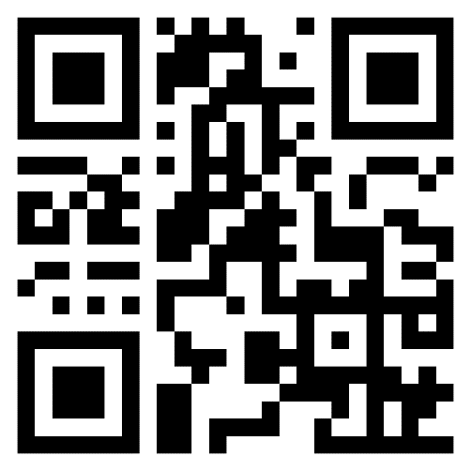
CHECK-IN
POINT
WACUBO 2025
Business Management Institute
Point your phone’s camera at the QR code
or
Navigate to https://wacubo.cnf.io
Tap session matching this room
Keep browser window open to check out at session’s end

Slide 3
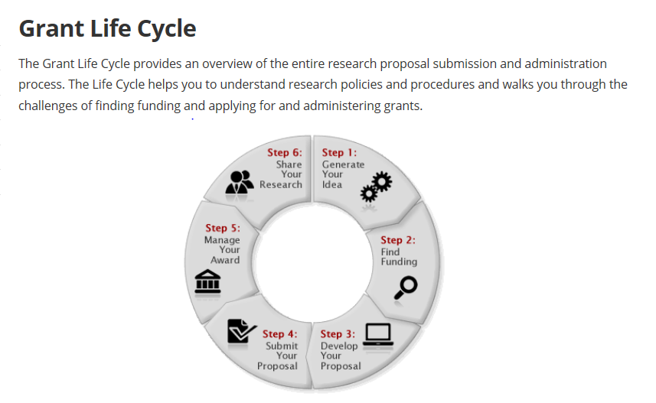
University of Utah - Overview

Slide 4
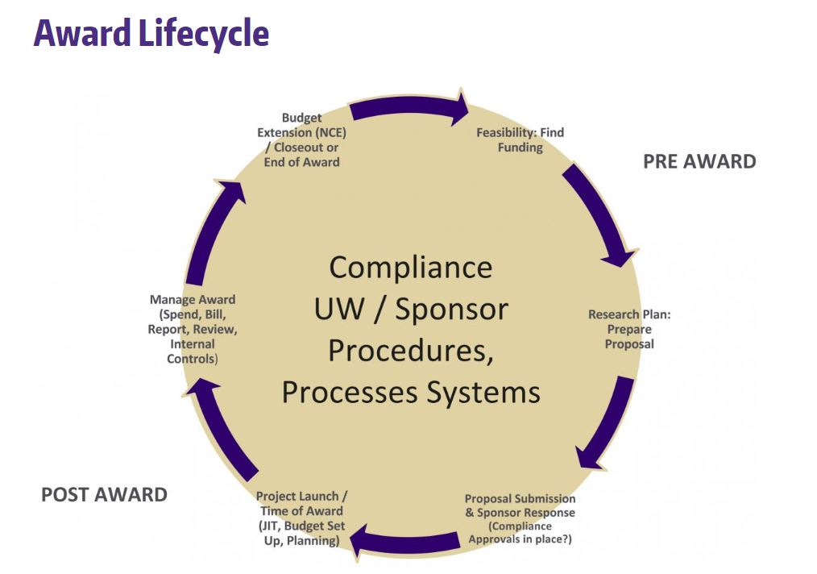
*University of Washington – Grants & Contracts Accounting
University of Washington Processes

Slide 5
What is a Sponsored Project?
University activity supported with funding or other resources provided by an external sponsor, with obligated deliverables in return.
Includes contracts, grants, cooperative arrangements, and other types of support agreements.
Project types include research, sponsored instruction, service projects, community service projects, and clinical trials.

Slide 6

Core Central and Departmental Administration Responsibilities
Serve the Faculty through individual project management; and serve the Administration (through monitoring operational metrics, to facilitate strategic decisions about the research enterprise)

Slide 7
Support Timeline Highlights
Pre-Award
  Program Development
  Identify research opportunities
  Grant Development Services
  Grant Proposal Preparation Assistance
  Online Proposal development tools
Grants & Contracts
  Review and provide institutional approval of proposals
  Submit proposals
  Negotiate terms and conditions of contracts with sponsors
  Institutional signatory
Post-Award
  Award set up
  Award Management
  Ongoing Sponsor Interaction

Slide 8
Administrative Components of Research Management (the “Players”)
Vice President of Research (et al.)
Office of Sponsored Projects or “Pre-Award”
Grants and Contracts Accounting or “Post-Award”
Accounting/Grants Officers/Specialists – in each “Award Type” and each “Sponsor” Area
Sponsored Project Award Billings (and Collections from Sponsors)
Websites – with links to: Federal Agencies and Regulations; University Policies, helpful Process Flowcharts
Cost Accounting and Analysis
Compliance Oversight and Reporting
IRB, IACUC, COI
Property Accounting
Deans, Chairs, Departments

Slide 9
Cost Accounting and Analysis
Institutional Costing Practices
Facilities and Administration (“F & A”) Rates Proposals and Rate Studies

Slide 10
Compliance Oversight and Reporting
Service and Recharge Centers Oversight
Effort Reporting and Certifications
Payroll Reallocation and Cost Transfers
Audit Coordination
Sub-recipient Monitoring
Fringe Benefit Rates (and their development)
  Only if fringe rates are federally negotiated
Internal Metric Reporting

Slide 11
Property Accounting
Record acquisitions of Capital Equipment, Buildings, Land, and the Improvements to Land
Inventories of Tagged Property (usually done Annually by a designated “Inventory Controller” in each Department)
Fabricated Equipment (properly account for costs and documentation)
University Surplus and Salvage (at end of the useful life, when replaced, or when otherwise disposed of)

Slide 12
Departmental Administration
Prepare and manage the Project Budget
Prepare any required Cost Transfers
Monitor Timely Submission of Effort Reports
Coordination with Project Sponsor’s representatives

Slide 13
Principal Investigators (“PI”s) – Training is Advised; A Sample Curriculum; Create a “PI Handbook”
Basic Highlights of Executing and Managing a Sponsored Award
Read the Contract and Award Details
Identify the Contract Type
Identify the Award Type
Governing Regulations (Understand and Comply)
Mandatory Agency Training or Disclosure(s)
Manage the Award

Slide 14
What kind of Research takes place at your institution ? Which Sponsors are in your Portfolio ?
Contract Types:
Contracts
Cooperative Agreements
Grants
Subcontracts

Slide 15
Contract Types
Contract:
Purpose:
Acquisition of property, product or services (“Deliverables”) for direct benefit or use of the Government or other Sponsor.
Involvement:
Government/Contractor involvement is substantial; a specific statement of work is expected to be accomplished.

Slide 16
Contract Types
Cooperative Agreement:
Purpose:
To transfer anything of value from the Government/Sponsor to the recipient to carry out a public or specific purpose.
Involvement:
Substantial involvement between the Government/Sponsor and the university in carrying out the purpose.

Slide 17
Contract Types
Grant:
Purpose:
To transfer anything of value from the Government/Sponsor to the recipient to carry out a public or specific purpose.
Involvement:
Minimal involvement by the Government/Sponsor; the university is responsible for determining and carrying out the activity.

Slide 18
Contract Type
Subcontract:
Purpose:
Sub-award to a sub-recipient to carry out the work specified in an award.
Involvement:
Significant involvement by the recipient; the sub-recipient has responsibility of making programmatic decisions and timely providing agreed-upon deliverables.

Slide 19
How does the Expenses and Revenues Process Work ????
Award Types:
  Cost-Reimbursement
  Fixed Amount

Slide 20
Award Types
Cost-Reimbursement:
Contract under which allowable, allocable and reasonable costs incurred by a contractor in the performance of a contract are reimbursed in accordance with the terms of the contract (i.e. – per the terms of the Award).

Slide 21
Award Types
Fixed Amount:
Contract under which a specific level of support is provided without regard to ACTUAL costs incurred.

Slide 22
Governing Regulations
“F A R” – Federal Acquisition Regulations
“U G” – Uniform Guidance 2 CFR 200
OMB Circulars
Specific Agency Rules and Regulations
University Policies and Procedures
Cost Accounting Standards (“CAS”)
Disclosure Statement (DS-2)

Slide 23
Costs
Remember these KEY CONCEPTS:
Allowable
Allocable
Reasonable

Slide 24
Uniform Guidance Cost Principles
Allowability of Costs (UG – 2 CFR 200.403)
Costs must be necessary and reasonable
Conform to any limitations or exclusions (specific award terms in a contract can override general terms)
Be consistent with policies and procedures of the Government and the University
Be accorded consistent treatment
Be adequately documented

Slide 25
Allowable / Unallowable
Examples of Unallowable Costs:
  Alcoholic Beverages
  Food – usually NOT allowed unless it is for a seminar or conference OR Food is specifically written into the award by the Sponsor
  Alumni Costs
  Bad Debts and related costs
  Vehicles provided to University Officers
  Donations and contributions
  Entertainment costs
  First Class air travel – unallowable unless medically necessary
  Interest paid to other University departments
  Membership costs in any country, social or dining club

Slide 26
Uniform Guidance Cost Principles
Allocable Costs (UG 2 CFR 200.405)
Chargeable or assignable to that Federal award or cost objective in accordance with relative benefits received
Is incurred specifically for the award
May not be charged to other awards to overcome fund deficiencies or to avoid restrictions imposed by Federal statutes or regulations
Must be allocated to the contract pursuant to the Cost Accounting

Slide 27

COST
TRANSFERS
$$ $$

Slide 28
Cost Transfers
Federal regulations state that “Clerical or bookkeeping errors should be accomplished within 90 days of when the error was discovered.” Agency and University policy stipulate that your awards should be reviewed at least every 30 days.
Use Management Report – an online tool (review at least monthly).

Slide 29

Effort Reporting

Slide 30
Effort Reporting – Effort Distribution
Compensation for sponsored projects should be consistent with approved sponsor budget.
Minor deviations from budgets are OK, but project commitment must be fulfilled.
Effort on projects must be certified (YOU HAVE OPTIONS!) Quarterly; Semiannually; Each Semester; Other. Depends on your Institution’s certification schedule.
Project effort reporting is based on payroll data and must tie to the accounting system.

Slide 31
Helpful Hints
Monitor the posted payroll distributions after each Pay Period
Any ongoing, significant changes between ACTUAL effort and the EFFORT recorded in the payroll system should be corrected as soon as possible

Slide 32
Property Accounting
REPORTING REQUIREMENTS OF UNIVERSITY PROPERTY:
It is the responsibility of each department or entity which acquires, holds, or disposes of University and government property to ensure that such property is:
  1. Properly reported when acquired
  2. Properly inventoried and safeguarded
  3. Properly reported at time of disposal

Slide 33
Property Accounting
Title to property acquired under a grant or contract shall be determined at the time of acquisition.
Generally, title is either:
Retained by the granting agency.
Vested in the University at the time of acquisition.
Temporarily vested in the University, with the agency reserving the right to transfer title to:
(1) The agency.
(2) Another institution, if the principal investigator transfers.
(3) The University on a permanent basis, generally upon completion of the project.

Slide 34
Award Closeout
Closeout (UG 2 CFR 200.343)
All financial, performance, and other reports must be submitted within 90 days of award end date.
Final invoice must be submitted within the 90 day window or else any unbilled costs will not be paid.
No-cost extension can be requested, but must be within the 90 day window or the request will be denied.

Slide 35
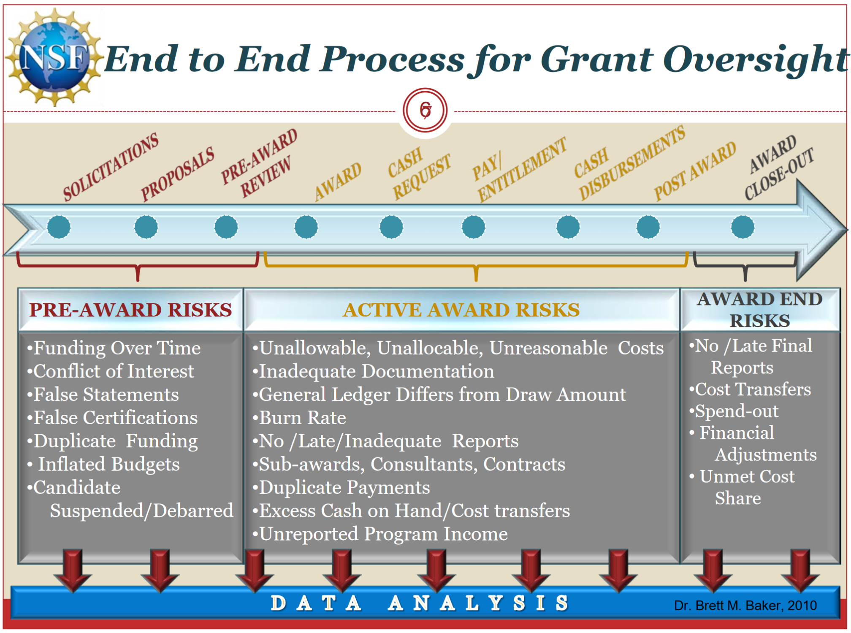

Slide 36
Case Study
From: Heckava Day
Sent: Monday, May 22, 2021 11:07 AM
To: Bob Compliance
Subject: Compliance Issues
Hi Bob…
I am in a difficult situation and was hoping you could give me some recommendations from a compliance standpoint.
One of the Geology and Geophysics PI’s, Dr. Les DoWhatIWant Edwards, has historically requested that expenditures be placed on “whatever projects have money”, regardless as to whether they are NSF, DWQ or other sponsored projects or whether they were on the same award or not. Since shortly after starting to work here and upon having received initial training through Grants & Contracts, I have worked with the office staff in communicating to Dr. Edwards that he provide chartfields or project names for his expenditures and that staff could not select where to move these funds.

Slide 37
Case Study
Dr. Edwards continues to have difficulty communicating with our payroll specialists in setting up salaries on his projects. He also has been putting costs onto projects that he admits do not belong there but justifies this in saying that OSP and GCA are not setting the projects up in time and he has to proceed with the research and has to use whatever project numbers are available.
I don’t know what to do. Our departmental staff already spoke to HR in June 2017 about the compliance issues as well the extremely hostile work environment that Dr. Edwards had created, but as far as I know he has a clean record and little was done to rectify our issues. From what I understand, our prior OSP rep, Learning Abroad, and possibly several GCA employees have experienced these “communication” difficulties with Dr. Edwards. To give credit, he has been less abusive and has been somewhat avoidant, so maybe this was worth the risk we took in approaching HR about these issues.

Slide 38
Case Study
I don’t know what to do. Dr. Edwards has relationships throughout the Main Administration building due to his role in the Academic Senate, and I believe this is why his Cost Transfers, Travel exceptions, etc. were approved without question and why HR did nothing to help us with our hostile work environment issues. As an interesting development, Dr. Edwards is now also Associate Dean over Faculty and Policy for our College.
Is there someone I can go to that can help? I am not sure HR is the best route anymore. I worry that we are trained by Grants & Contracts training in a way that some departments, colleges, and some individuals at the University Administration building do not fully support. Are we or are we not supposed to just “zero out” projects through effort reporting certifications and expenditure reallocation? Please help me understand how to survive these conflicts.
I appreciate any feedback you can give me. I honestly do not know where I should go.
Thanks,
Heckuva Day

Slide 39
Case Study
Is there someone I can go to that can help? I am not sure HR is the best route any more. I worry that we are trained by Grants & Contracts training in a way that some departments, colleges, and some individuals at the University Administration building do not fully support. Are we or are we not supposed to just “zero out” projects through ePAR’s and expenditure reallocation? Please help me understand how to survive these conflicts.
I appreciate any feedback you can give me. I honestly do not know where I should go.
Thanks,
Heckuva Day

Slide 40

Final Exam to come Later

Slide 41
Looking to Obtain CPEs?
Don’t forget to Check-Out from the system!

