Slide 1
SOAR: Strengths, Opportunities, Aspirations, Results
S
O
What are we the best at?
What are we most passionate about?
What capabilities and resources do we have that are unique to us?
How or where do we exceed expectations?
What do others see as our strengths?
What advantages do we have?
What trends in our environment (social, technological, policy) can we leverage?
Are there unmet needs or gaps we are well-positioned to fill?
Who could we collaborate with to amplify our strengths?
How can we use innovation to reach new stakeholders or increase value?
A
R
What do we care deeply about becoming?
How do we want to be known by our stakeholders or communities?
What would bold success look like in the next 3–5 years?
How can we build a culture that reflects our highest ideals?
What outcomes will tell us we’re making progress?
What does success look like for our aspirations?
How will we measure impact beyond just financial results?
What indicators would energize and motivate our team?

Slide 2
SOAR: Strengths, Opportunities, Aspirations, Results
S
O
A
R

Slide 3
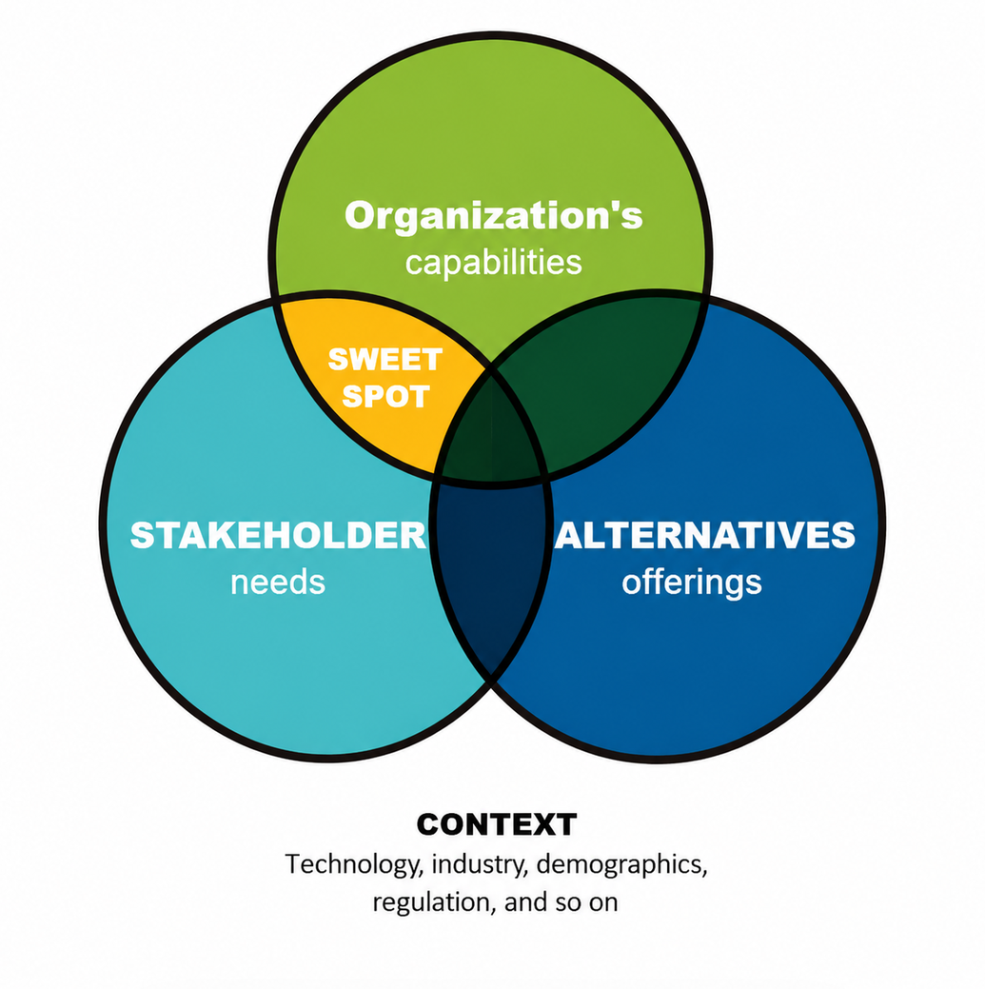

Slide 4
Institutional Targets
URM 4-yr grad rate: 75%
First Gen 4-yr grad rate: 75%
Pell Eligible 4-yr grad rate: 75%
All Students 4-yr grad rate:75%
URM 2-yr transfer grad rate: 70%
First Gen 2-yr transfer grad rate: 70%
Pell 2-yr transfer grad rate: 70%
All Students 2-yr transfer grad rate: 70%
SAMPLE BALANCED SCORECARD
We support and enhance student and faculty success through transformative, evidence-based teaching and learning practices
MISSION
Strategic Objectives
Intermediary KPIs
Output KPIs
Strategic Initiatives
Community
Partnerships
and Impact
Provide Coordinated and Informed Collaboration w/ Campus Partners
Increase Community Awareness, Messaging, and Marketing of Our Services
Increase Advancement Support and Participation
# joint grant submittals
Joint grants awarded and $$
Perform program reviews with ABC
Identify and expand of Digital Delivery for online courses
Develop new faculty onboarding; faculty fellows programming
Expand services to DEF, GHI, JKL
Rebrand XYZ
Develop new pipeline models with …
Initiate joint fundraising with …
Implement annual Strategic Focus Retreat
Review hiring and lifecycle practice
Invest in professional & student staff training
Include EDI into performance review
Develop internal documentation & library
ITS unification in platforms
Financial/ Stakeholder
# of campus collaborations formed/sustained
National articles recognizing XYZ
# of faculty/student speaker series
Student grades improvements
# consultations provided
Faculty assessments improvements
# of campus outreach
Student participant persistence & retention
Customer
Expectations
# of student / faculty hours at XYZ
“What are we going to do?”
Provide Clear and Coordinated Support for Campus Stakeholders
Develop Faculty & Student Support Programs That are Versatile, Holistic, and Responsive
Partner with Faculty to Innovate and Improve Outcomes for All Students
# of referrals to XYZ
Faculty & Staff Satisfaction Survey scores
# repeat XYZ usage by student, faculty
Student Satisfaction Survey scores
Systemwide UG Survey scores
# new programs delivered
Systemwide Grad Survey scores
# new students and faculty participants
Internal
Processes
Develop Accountable and Transparent Practices that are Inclusive
Enable Cross-Unit Informed and Coordinated Support for Campus Stakeholders
Simplify policies and procedures to promote operational efficiencies
# of processes streamlined & documented
XYZ Staff@Work Survey scores (on valuable training & development, spirit of cooperation, and behavior & conduct, overall satisfaction, etc.)
% time savings realized from process optimizations
% completion of programs & services eval plans
# of facilitated internal trainings
People &
Culture
Sustain Equity-focused Structure, Processes, and Practices
Foster an Asset-based Approach to Employee Wellness and Development
Exemplify a Work Environment That is Trusting, Respectful, and Constructive
% response rates for staff surveys
eNPS score on S@W Survey
% participation in training and development
XYZ Climate Survey scores
% participation in voluntary team activities
Turnover and Retention
XYZ Diversity Dashboards goals
VALUES
Core Values: Transformation, Belonging, Collaboration, Authenticity, Compassion

Slide 5
Your University Name:
University Mascot:
University Unit:
Team Members:
Why do you exist, whom do you serve, how do you do it?
Unit’s Mission
Strategic Objectives: List 2-3 Objectives and Draw Arrows to Indicate Cause and Effect
Measures: How will measure success
Strategic Initiatives: List 1-2 Initiatives to execute on our Objectives in the next three years
1.
2.
3.
Financial/
Stakeholder
1.
2.
1.
2.
Customer
1.
2.
3.
1.
2.
1.
2.
Internal
Processes
1.
2.
3.
1.
2.
1.
2.
1.
2.
3.
1.
2.
People &
Culture
1.
2.
Core Values
What values must be upheld for your team to deliver on the university’s mission?

